Slide 1
Quantitative Trait Mapping with qtl2
Sue McClatchy, The Jackson Laboratory
Dan Gatti, The Jackson Laboratory

Slide 2
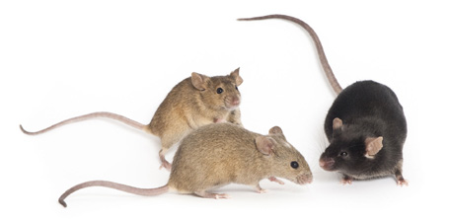
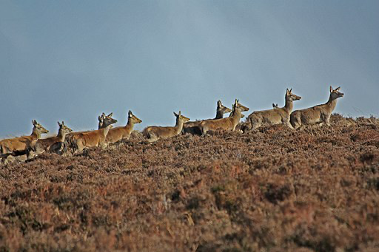
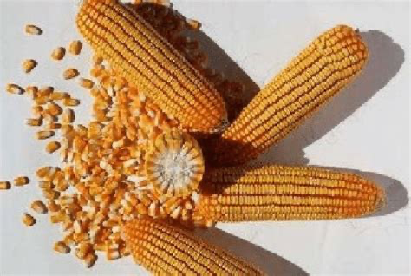
Mapping in biomedical, agricultural & evolutionary studies
Diversity Outbred mice
jax.org
Zheng 958 maize
Li X, Du Y, Guo J and Mao E. Appl Sci 2020, 10. researchgate.net
The Wild Red Deer of Exmoor
John Shortland
Wikimedia Commons
Notes:
Quantitative trait locus (QTL) mapping is used in biomedical, agricultural, and evolutionary studies to find causal genes for quantitative traits, to aid crop and breed selection in agriculture, and to shed light on natural selection.
Examples of quantitative traits include cholesterol level, plant yield, or birth weight, all of which are continuous variables.
The goal of quantitative trait locus (QTL) analysis is to identify genomic regions linked to a phenotype, to map these regions precisely, and to define the effects, number, and interactions of QTL.

Slide 3
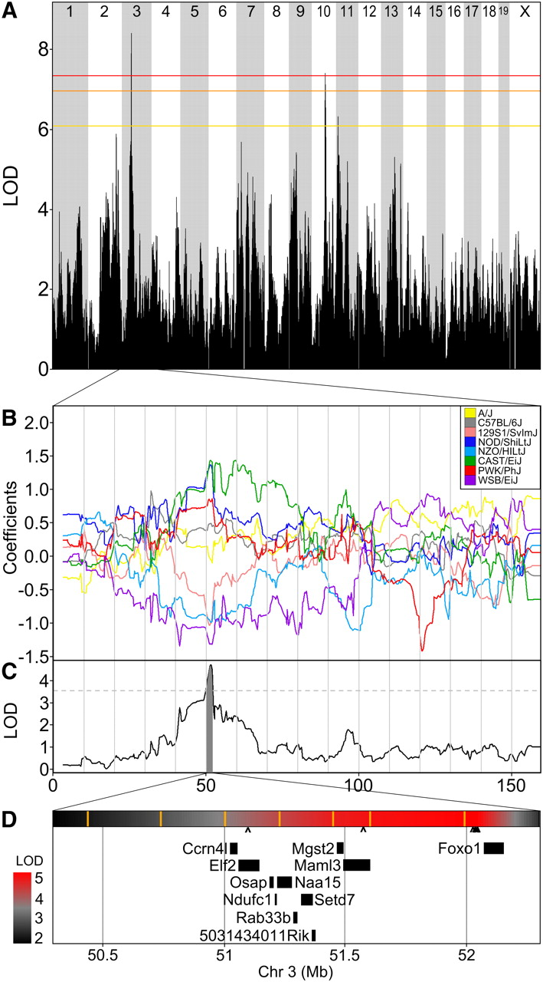

Figure 6 Change in plasma cholesterol has a significant QTL on chromosome 3.
QTL mapping in biomedicine aims
to identify causal genes for
quantitative traits like cholesterol levels
Notes:
Figure 6 Change in plasma cholesterol has a significant QTL on chromosome 3.
(A) Genome-wide scan for change in cholesterol from 7 to 18 weeks of age. Colored lines show permutation-derived significance thresholds at P = 0.05 (red), P = 0.10 (orange), and P = 0.63 (yellow).
(B) The eight coefficients of the QTL model show the effects on the phenotype contributed by each founder haplotype on chr 3.
(C) QTL plot for the chr 3 locus. Shading identifies a two-LOD support interval. Dashed line is maximum LOD −2.
(D) Expansion of the two-LOD support interval containing 11 genes. A heatmap of the QTL P-value is shown above the gene locations with SNP locations indicated by orange vertical bars. The scale of significance (red most significant) is shown on the left. The seven Sanger SNPs that match the founder effect pattern are marked beneath the heat map with carats (^); five of these cluster upstream of Foxo1.
Unless provided in the caption above, the following copyright applies to the content of this slide: © Genetics 2012 This article is published and distributed under the terms of the Oxford University Press, Standard Journals Publication Model (https://academic.oup.com/journals/pages/open_access/funder_policies/chorus/standard_publication_model)

Slide 4
QTL mapping in agriculture aids
crop selection and improvement
Yang, J., Liu, Z., Chen, Q. et al. Mapping of QTL for Grain Yield Components Based on a DH Population in Maize. Sci Rep 10, 7086 (2020).
Notes:
In agriculture traits identifying causal genes for traits like plant yield are important for improving plant productivity.

Slide 5
Mapping birth weight in a
natural population sheds light
on natural selection
Slate J, Visscher PM, MacGregor S, Stevens D, Tate ML, Pemberton JM. A genome scan for quantitative trait loci in a wild population of red deer (Cervus elaphus). Genetics. 2002 Dec;162(4):1863-73.
Notes:
QTL mapping in wild populations aims to characterize the genetic architecture of traits like birth weight. Environmental variance is high in wild, unmanipulated populations relative to experimental crosses, so the heritability of a trait will be lower than in an experimental population. Wild populations are good for characterizing allelic distribution and selection intensity.

Slide 6
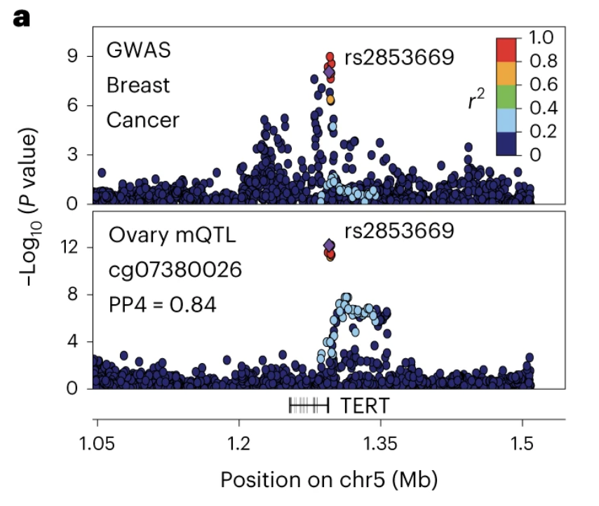
Human studies - expensive, lack environmental control, confounded
Oliva, M., Demanelis, K., Lu, Y. et al. DNA methylation QTL mapping across diverse human tissues provides
molecular links between genetic variation and complex traits. Nat Genet 55, 112–122 (2023)
Notes:
Human populations could also be considered natural populations with high environmental variance much like that in a population of red deer.
Human studies are very expensive and prone to being confounded by population structure such that associations between genotype and phenotype are not necessarily causal.

Slide 7
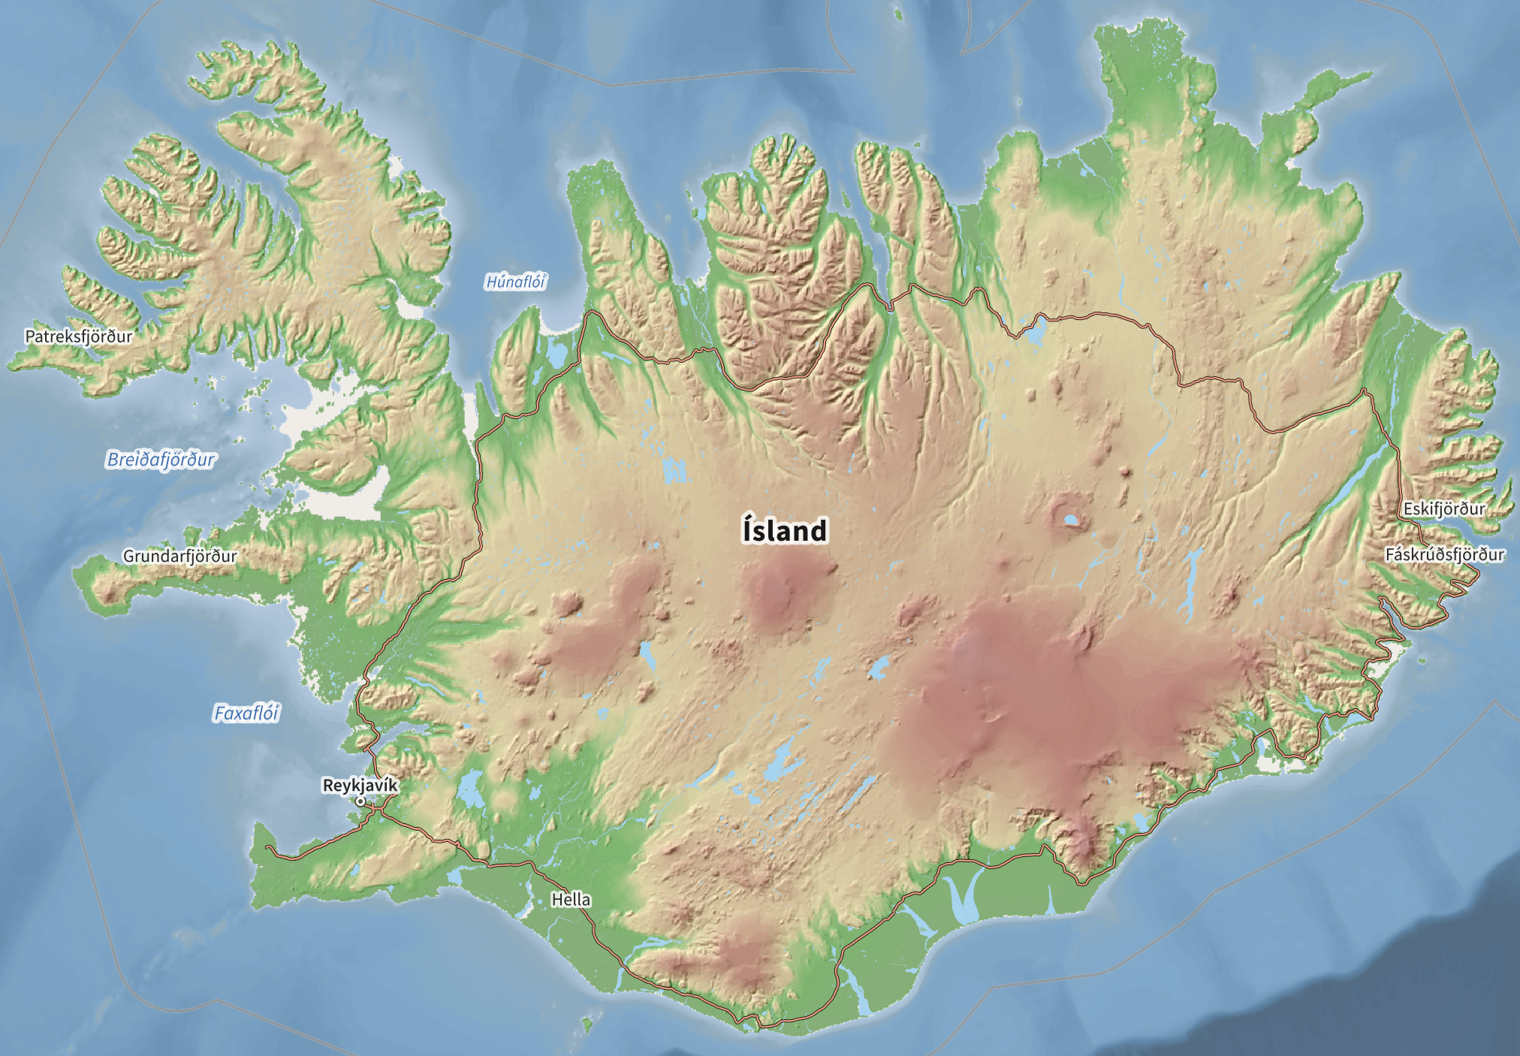
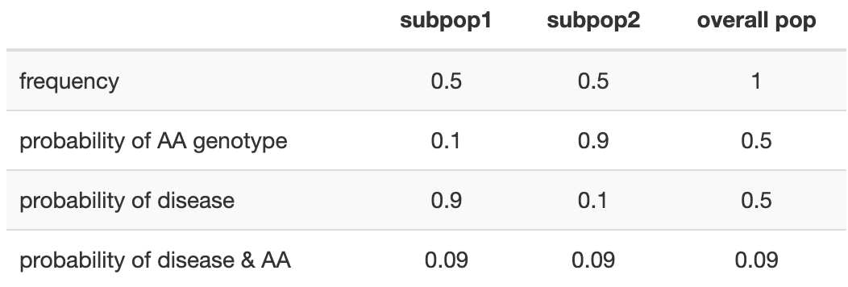
Confounding by population
structure
Notes:
Case-control studies are often confounded when hidden subpopulations with different allele frequencies and disease probabilities are present in the study.
If the probability of the AA genotype in the overall population is 0.5 and the probability of disease also 0.5, you would expect the joint probability of AA genotype and disease to be 0.5 times 0.5 = 0.25.
In fact this joint probability is much lower at only .09.
The culprit is a hidden subpopulation with a high probability of disease but low probability of AA genotype.
If a study sample includes an unknown subpopulation of Icelanders, for example, most of the cases will come from this unknown subpopulation that in this case has a high probability of disease but a low probability of having the AA genotype.
The study will be confounded by population structure and the association between genotype and phenotype not causal.

Slide 8
Two or more strains that differ genetically
a marker
R/qtl2: high-dimensional data and multi-parent populations. kbroman.org/talks.html
Notes:
QTL mapping in experimental crosses requires two or more strains that differ genetically with regard to a phenotype of interest.
Genetic markers, such as SNPs or microsatellites, distinguish between parental strains in the experimental cross.
At lower right we see a marker indicating that this F2 is heterozygous at the marker, carrying one allele from each parental strain.
Markers that are genetically linked to a phenotype will segregate more often with phenotype values (high or low values, for example), while unlinked markers will not be significantly associated with the phenotype.
The markers themselves might be associated with the phenotype but are not causal.
Rather, markers may be associated with the phenotype through linkage to nearby QTL.
They serve as signposts indicating the neighborhood of a QTL that influences a phenotype.
Covariates such as sex or diet can also influence the phenotype.

Slide 9
Figure 6 Change in plasma cholesterol has a significant QTL on chromosome 3.
Notes:
In the last part of this course we will explore
Figure 6 Change in plasma cholesterol has a significant QTL on chromosome 3.
(A) Genome-wide scan for change in cholesterol from 7 to 18 weeks of age. Colored lines show permutation-derived significance thresholds at P = 0.05 (red), P = 0.10 (orange), and P = 0.63 (yellow).
(B) The eight coefficients of the QTL model show the effects on the phenotype contributed by each founder haplotype on chr 3.
(C) QTL plot for the chr 3 locus. Shading identifies a two-LOD support interval. Dashed line is maximum LOD −2.
(D) Expansion of the two-LOD support interval containing 11 genes. A heatmap of the QTL P-value is shown above the gene locations with SNP locations indicated by orange vertical bars. The scale of significance (red most significant) is shown on the left. The seven Sanger SNPs that match the founder effect pattern are marked beneath the heat map with carats (^); five of these cluster upstream of Foxo1.
Unless provided in the caption above, the following copyright applies to the content of this slide: © Genetics 2012 This article is published and distributed under the terms of the Oxford University Press, Standard Journals Publication Model (https://academic.oup.com/journals/pages/open_access/funder_policies/chorus/standard_publication_model)

Slide 10
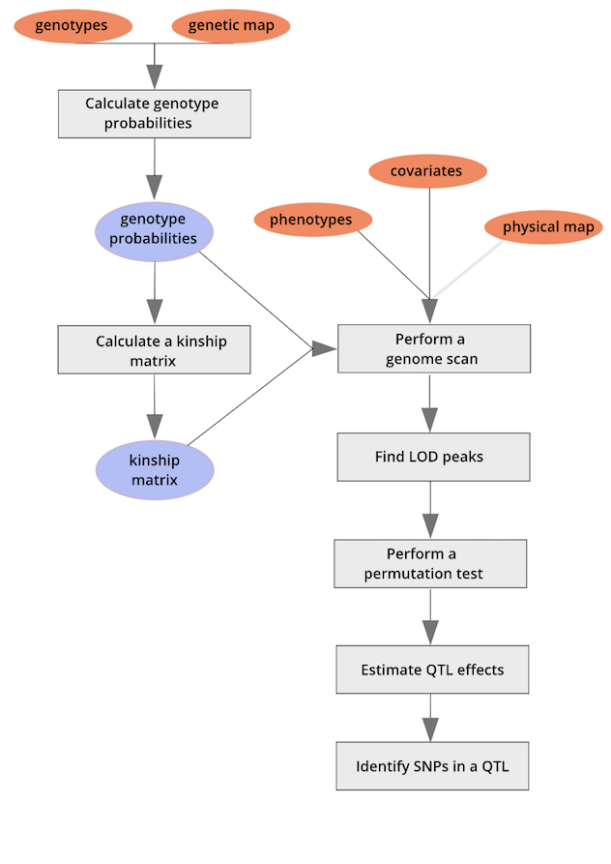
Mapping workflow
Notes:
The qtl mapping workflow starts with genotypes and a genetic map.
From these data we calculate genotype probabilities, the probability of each genotype between typed markers.
We use the genotype probabilities to calculate a kinship matrix that describes the genetic relatedness between individuals in our data.
The kinship matrix, phenotypes, any covariates and an optional physical map are used to scan the genome for loci that explain phenotypic variation.
We find logarithm-of-odds (LOD) peaks within the genome scan to locate QTL.
A permutation test indicates how large a LOD score we can get just by random chance, so that we know how high a score needs to be to considered significant.
We estimate the effects of the QTL on the phenotype and finally identify any SNPs in the QTL.
What isn’t shown here are some new developments in this lesson: an introduction to expression QTL (eQTL) and mediation analysis.

Slide 11
Introducing the first data set

Slide 12
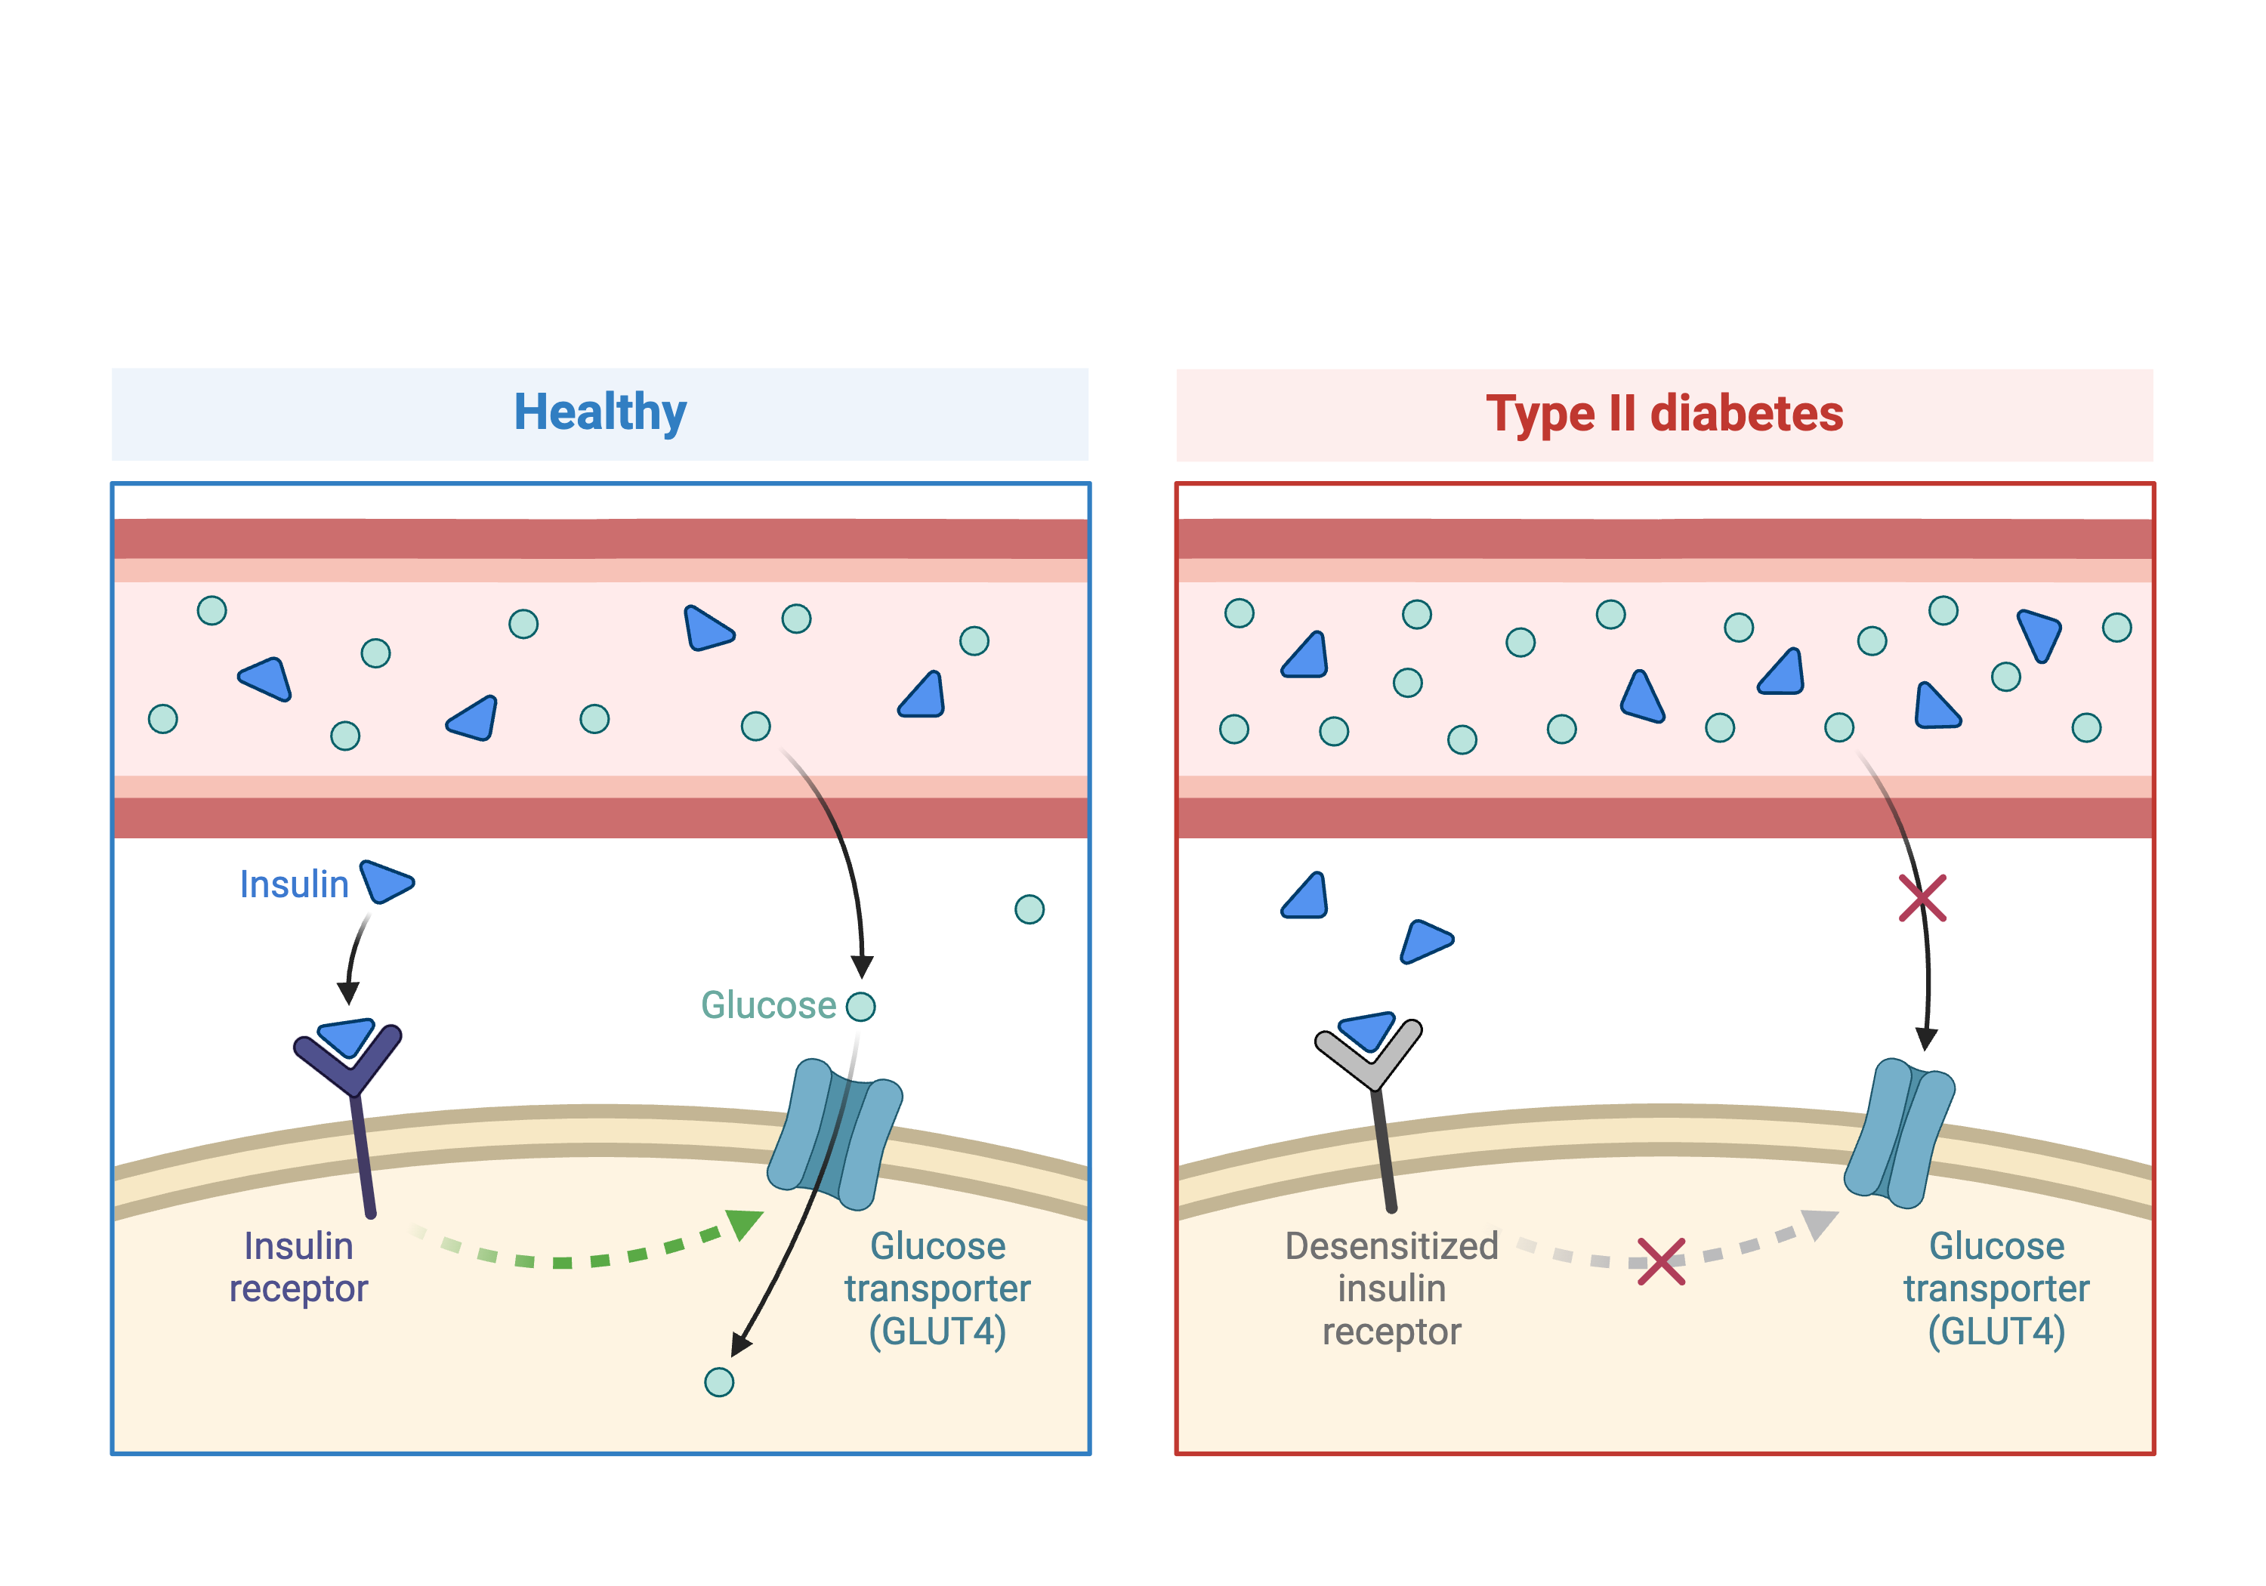
Insulin resistance and blood glucose
Tian, Jianan et al. “Identification of the Bile Acid Transporter Slco1a6 as a Candidate Gene That Broadly Affects Gene Expression in Mouse Pancreatic Islets.” Genetics vol. 201,3 (2015): 1253-62.
Notes:
In the first part of this lesson, we will be analyzing data from a mouse experiment involving Type 2 diabetes (T2D).
In Type 2 diabetes the pancreas makes less insulin and the body becomes less responsive to insulin.
The data we start with are from a study by Tian et al and involves an intercross between the diabetes-resistant C57BL/6J strain and the diabetes-susceptible BTBR strain.

Slide 13
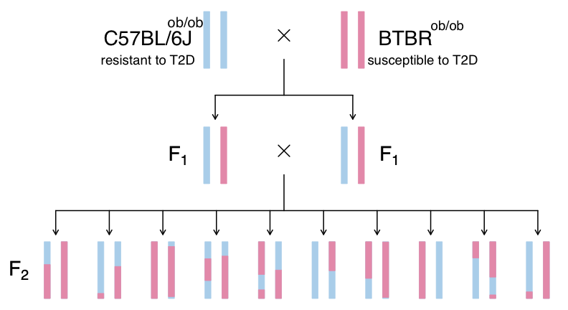
Leptin (ob) regulates hunger and satiety
Notes:
Leptin^{ob/ob} mice continue to eat and become obese.
Obesity is one of the risk factors for type 2 diabetes.
This experiment uses genetic variation between strains C57BL/6J, which is diabetes-resistant, and BTBR, which is diabetes-susceptible.
The F2s are all homozygous Leptin^{ob/ob} mutants.
This study measured insulin and glucose levels in mice at 10 weeks.
We will map circulating insulin levels to identify genomic loci which influence insulin levels.

Slide 14
Challenge 1: Research question and study design
Notes:
Challenge 1: Research question and study design
Turn to a partner and describe: 1. the research question that the study addresses, and 2. how the study is designed to address this question.
Share your description with your partner, and then listen to them describe their understanding of the study. When you are finished, write your responses into the collaborative document.

Slide 15
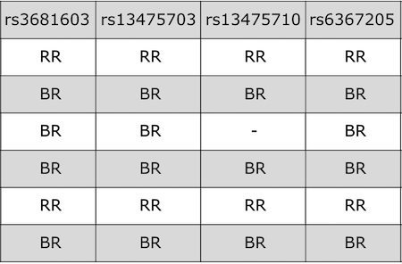
Input file format - genotypes
Notes:
QTL mapping data consists of a set of tables of data: sample genotypes, phenotypes, marker maps, etc.
These different tables are in different comma-separated value (CSV) files.
In each file, the first column is a set of IDs for the rows, and the first row is a set of IDs for the columns.
For example, the genotype data file will have individual IDs in the first column, marker names for the rest of the column headers.
The sample genotype file above shows two alleles: B and R.
These represent the founder strains for an intercross, which are C57BL/6 (BB) and BTBR (RR) Tian et al.
The B and R alleles themselves represent the haplotypes inherited from the parental strains C57BL/6 and BTBR.
In the first column we would have sample IDs, although they don’t show in this graphic.

Slide 16
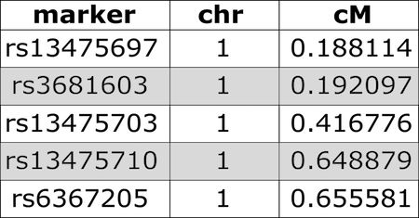
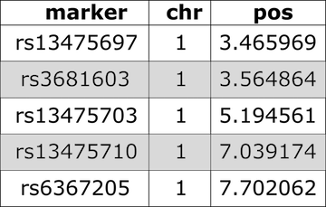
Input file format – genetic and physical maps
Notes:
We use both a genetic marker map and a physical map (if available).
A sample from a genetic map of SNP markers is shown at left.
A physical marker map on the right provides location in megabases rather than centiMorgans.

Slide 17
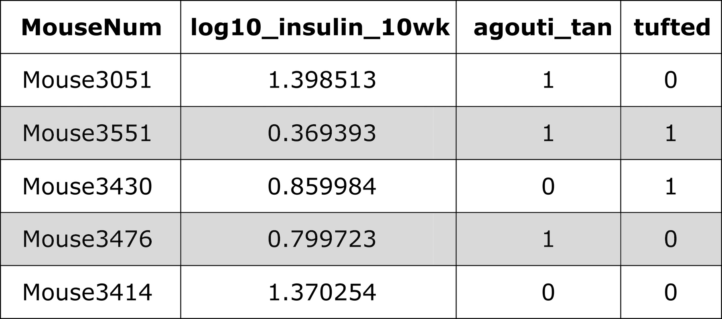
Input file format – phenotypes
Notes:
The continuous phenotype we will map first is the base 10 log of insulin at 10 weeks of age.
In addition to insulin there are two binary (yes/no) phenotypes – agouti and tufted coat.
We will learn how to map binary phenotypes like these along with continuous ones like insulin.

Slide 18
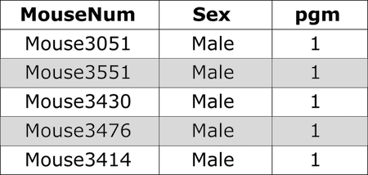
Input file format – covariates
Notes:
Phenotype covariates are metadata describing the phenotypes.
The covariates shown include sex and the strain of the parental grandmother (pgm) represented as a 0 or 1.

Slide 19
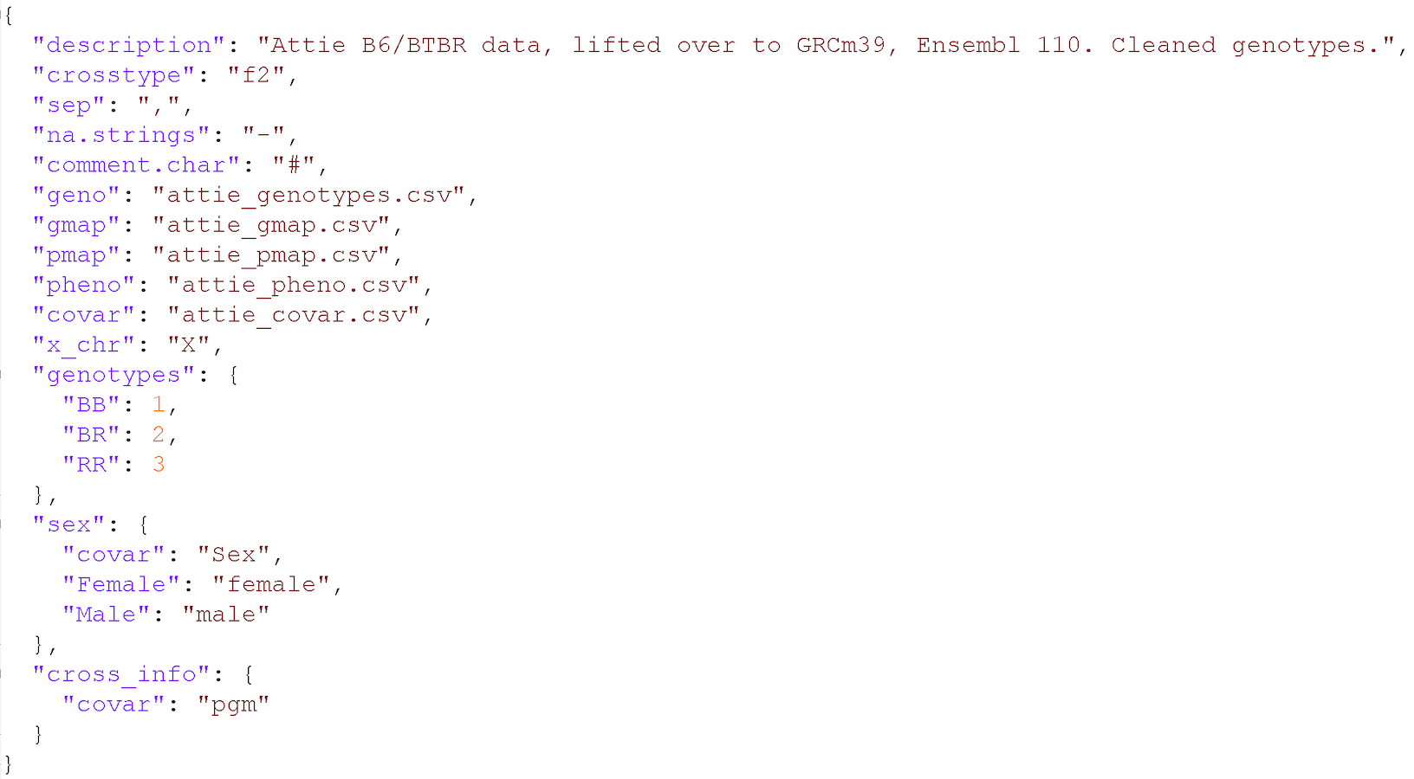
Input file format – control file
Notes:
In addition to the set of CSV files with the primary data, we need a separate control file with various control parameters (or metadata), including the names of all of the other data files and the genotype codes used in the genotype data file.
The control file is in a specific format using either YAML or JSON.
These are human-readable text files for representing relatively complex data.
A big advantage of this control file scheme is that it greatly simplifies the function for reading in the data.
That function, read_cross2(), has a single argument: the name (with path) of the control file.

Slide 20
Challenge 1: What data does qtl2 need?
Notes:
Challenge 1: What data does qtl2 need?
Which data files are required by qtl2?
Which ones are optional?
How should they be formatted?

Slide 21
Challenge 2: Additional R/qtl2 datasets
Notes:
Challenge 2: Additional R/qtl2 datasets
Go to https://github.com/rqtl/qtl2data to view additional sample data. 1). Find the Recla data and locate the phenotype data file. Open the file by clicking on the file name. What is in the first column? the first row? 2). Locate the genotype data file, click on the file name, and view the raw data. What is in the first column? the first row? 3). Locate the covariates file and open it by clicking on the file name. What kind of information does this file contain? 4). Locate the control file (YAML or JSON format) and open it. What kind of information does this file contain?

